Slide 1
RStudio::conf 2019
The Best Bits
Cameron Fairfield
20/02/2019
Surgical Informatics Group

Slide 2
Overview
RStudio::conf format
Big data workshop
Tidy eval
GT package
Notable mentions
RStudio::conf 2020

Slide 3
RStudio::conf 2019
Format

Slide 4
Workshops (Day 1-2)
Machine Learning
Shiny and Markdown
Applied Machine Learning
Introduction to Shiny and R
Introduction to Deep Learning and Deep Learning: Beyond the Basics
Intermediate Shiny
Shiny in Production
Advanced R Markdown
Misc.
Data Science in the Tidyverse
Building Tidy Tools
RStudio Professional Administrator Certification
Education
Shiny Train-the-Trainer
What They Forgot To Teach You About R, aka Getting S*%! Done in R
Tidyverse Train-the-Trainer
Big Data with R

Slide 5
Main Conference (Day 3-4)
Keynote Speeches:
RStudio vision
Shiny in production: Principles, practices, and tools
Explicit Direct Instruction in Programming Education
The Unreasonable Effectiveness of Public Work
Panel discussion – Growth and Data Science: Individuals, leaders, organisations and responsibilities
Hilary Parker (Stitch Fix)
Larthik Ram (UC Berkeley)
Angela Bassa (iRobot)
Tracy Teal (Carpentries)
Eduardo Arino de la Rubia (DataScience.LA)

Slide 6
Break-out Sessions
Interoperability
Professional / RStudio features
Tidyverse-ext
Applications / industry
Distributed / cluster computing
Teaching
Modelling
Workflow
Tidyverse-ext
Organisational thinking
Programming
Publication
Programming
Shiny
Teaching

Slide 7
Birds of a Feather
Networking opportunities at breakfast, lunch, coffee etc.
NLP
Data for “Good”
R-Admin
DevOps
Retail / CPG
Education
EdTech
Manufacturing
Business Intelligence
Finance
Healthcare and Insurance
Pharma and life Sciences
Academic / Research
Arrow
Data Science Managers
Spatial / Maps
StartUps
Energy
Media / Journalism
Government / Public Sector
Machine Learning
Package Development
Environmental / Ecology
Sports Analytics
R-Ladies

Slide 8
Tidyverse Developer Day
Saturday after the conference
Friendly debugging
Pull requests
Package development

Slide 9
Big Data Workshop

Slide 10
Big Data Workshop
Secure access to databases (no more storing passwords in scripts!)
Efficient data management – making the database do the hard work
The dbplyr package – use dplyr and generate SQL!
Construct a pipeline for regression analyses

Slide 11
Secure Access to Databases
Passwords in scripts
Better options:
Separate script
Yaml file
.Renviron file
Keyring package
Rstudioapi askforpass

Slide 12
Bad Practice
> con <- DBI::dbConnect(odbc::odbc(),
> Driver = "impala",
> Host = "database.rstudio.com",
> UID = “userid”,
> PWD = “password”
> )

Slide 13
Openssl::askpass
> openssl::write_pem(
> key,
> "id_rsa",
> password = “supersecret”)
> )
Greater password security as:
> openssl::write_pem(
> key,
> "id_rsa",
> password = openssl::askpass(prompt = "Please choose a password")
> )

Slide 14
Deployed Content – Prompt for Credentials
> library(shiny)
> library(DBI)
> library(odbc)
> server <- function(input, output, session) {
> data <- reactive({
> req(input$uid, input$pwd)
> con <- dbConnect(odbc::odbc(),
> Driver = "Postgres",
> Server = "mydb.company.com",
> Port = 5432,
> Database = "sales-data",
> UID = input$uid,
> PWD = input$pwd,
> )
> data <- dbGetQuery(con, "SELECT * FROM sales")
> dbDisconnect(con)
})
# ... some code that uses data() }

Slide 15
Deployed Content - .Renviron file
Create a script and enter the following:
> userid = "username"
> pwd = "password"
Save the script as ‘.Renviron’
Restart R session
> con <- DBI::dbConnect(odbc::odbc(),
> Driver = "impala",
> Host = "database.rstudio.com",
> UID = Sys.getenv("userid"),
> PWD = Sys.getenv("pwd")
> )

Slide 16
Encryptr package
Easy encryption of variables
Easy decryption
Follows safe password use
https://github.com/SurgicalInformatics/encryptr

Slide 17
Efficient Data Management
Avoid “heavy lifting” in RAM
Avoid pulling all the data with every transformation
Retrieve all required data when desired

Slide 18
Workable Example with Sparklyr
> library(tidyverse)
> library(dbplyr) #Lets you use dplyr instead of SQL
> library(sparklyr)
> library(nycflights13)
> library(ggplot2)
#Set up a local connection (should work on your system)
> sc <- spark_connect(master = "local")
‘sc’ should now be stored in the environment

Slide 19
Add in some data
> spark_flights <- sdf_copy_to(sc, flights, "my_flights")
‘spark_flights’ appears in local environment
‘my_flights’ appears in the connections pane

Slide 20
Transform the Data
> spark_flights %>%
> group_by(dest) %>%
> summarise(avg_delay = mean(arr_delay, na.rm = TRUE)) -> average_delay
> average_delay
# # Source: spark<?> [?? x 2]
# dest avg_delay
# <chr> <dbl>
# 1 IAH 4.24
# 2 PBI 8.56
# 3 BOS 2.91
# 4 CLT 7.36
# # ... with more rows

Slide 21
Collect the Data
average_delay %>%
collect()
# # A tibble: 105 x 2
# dest avg_delay
# <chr> <dbl>
# 1 IAH 4.24
# 2 PBI 8.56
# 3 BOS 2.91
# 4 CLT 7.36
# # ... with 101 more rows

Slide 22
dbplyr – how it works
> flights %>%
> summarise_if(is.numeric, mean, na.rm = TRUE) %>%
> show_query()
Applying predicate on the first 100 rows
<SQL>
SELECT AVG("flightid") AS "flightid", AVG("year") AS "year", AVG("month") AS "month", AVG("dayofmonth") AS "dayofmonth", AVG("dayofweek") AS "dayofweek", AVG("deptime") AS "deptime", AVG("crsdeptime") AS "crsdeptime", AVG("arrtime") AS "arrtime", AVG("crsarrtime") AS "crsarrtime", AVG("flightnum") AS "flightnum", AVG("actualelapsedtime") AS "actualelapsedtime", AVG("crselapsedtime") AS "crselapsedtime", AVG("airtime") AS "airtime", AVG("arrdelay") AS "arrdelay", AVG("depdelay") AS "depdelay", AVG("distance") AS "distance", AVG("taxiin") AS "taxiin", AVG("taxiout") AS "taxiout", AVG("cancelled") AS "cancelled", AVG("diverted") AS "diverted", AVG("carrierdelay") AS "carrierdelay", AVG("weatherdelay") AS "weatherdelay", AVG("nasdelay") AS "nasdelay", AVG("securitydelay") AS "securitydelay", AVG("lateaircraftdelay") AS "lateaircraftdelay", AVG("score") AS "score“
FROM datawarehouse.flight

Slide 23
Create a Pipeline
> mtcars_tbl <- copy_to(sc, mtcars, "mtcars")
> # transform our data set, and then partitions into 'training', 'test’
> partitions <- mtcars_tbl %>%
> filter(hp >= 100) %>%
> ft_bucketizer(input_col = “cyl”,
> output_col = “cyl8”,
> splits = c(0,8,12))) %>%
> sdf_partition(training = 0.5, test = 0.5, seed = 888)
> # fit a linear model to the training dataset
> fit <- partitions$training %>%
> ml_linear_regression(mpg ~ wt + cyl)

Slide 24
Execute a Pipeline
summary(fit)
## Call: ml_linear_regression(., mpg ~ wt + cyl)
##
## Deviance Residuals::
## Min 1Q Median 3Q Max
## -2.0947 -1.2747 -0.1129 1.0876 2.2185
##
## Coefficients:
## Estimate Std. Error t value Pr(>|t|)
## (Intercept) 33.79558 2.67240 12.6462 4.92e-07 ***
## wt -1.59625 0.73729 -2.1650 0.05859 .
## cyl -1.58036 0.49670 -3.1817 0.01115 *
## ---
## Signif. codes: 0 '***' 0.001 '**' 0.01 '*' 0.05 '.' 0.1 ' ‘ 1
##
## R-Squared: 0.8267
## Root Mean Squared Error: 1.437

Slide 25
Collect from the Pipeline Output
# Score the data
> pred <- sdf_predict(fit, partitions$test) %>%
> collect()
# Plot the predicted versus actual mpg
> ggplot(pred, aes(x = mpg, y = prediction)) +
> geom_abline(lty = "dashed", col = "red") +
> geom_point() +
> theme(plot.title = element_text(hjust = 0.5)) +
> coord_fixed(ratio = 1) +
> labs(x = "Actual Fuel Consumption",
> y = "Predicted Fuel Consumption",
> title = "Predicted vs. Actual Fuel Consumption"
> )

Slide 26
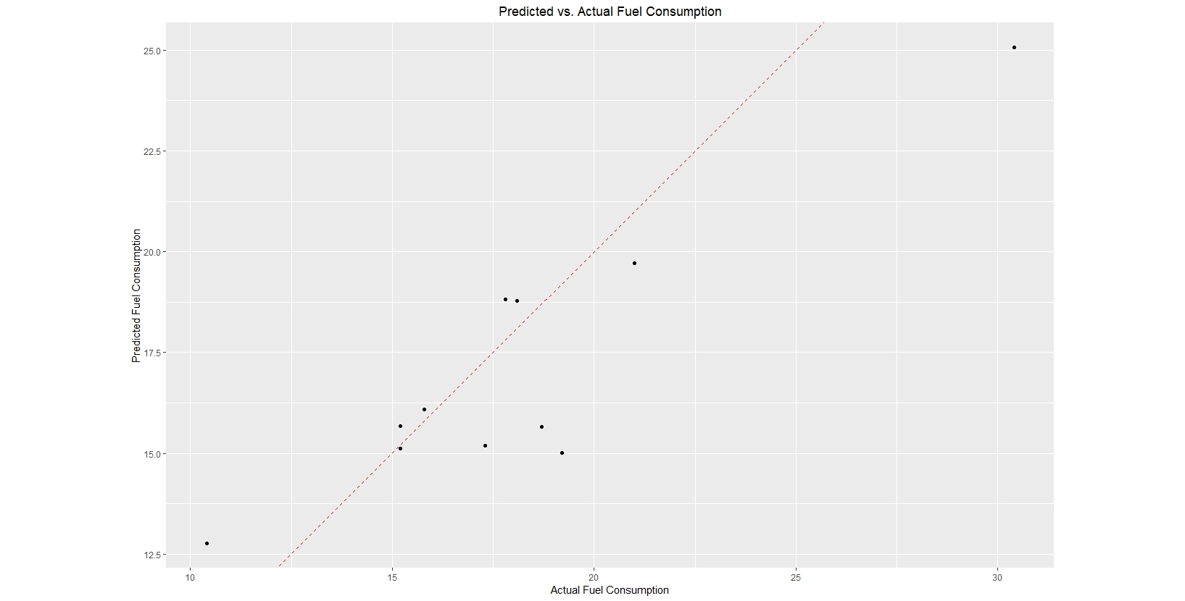

Slide 27
Disconnect from Spark Cluster
> spark_disconnect(sc)

Slide 28
GT Package

Slide 29
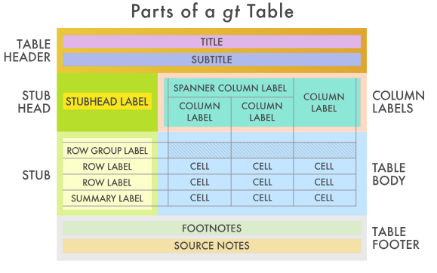
GT Package - Easily Create Presentation-Ready Display Tables

Slide 30
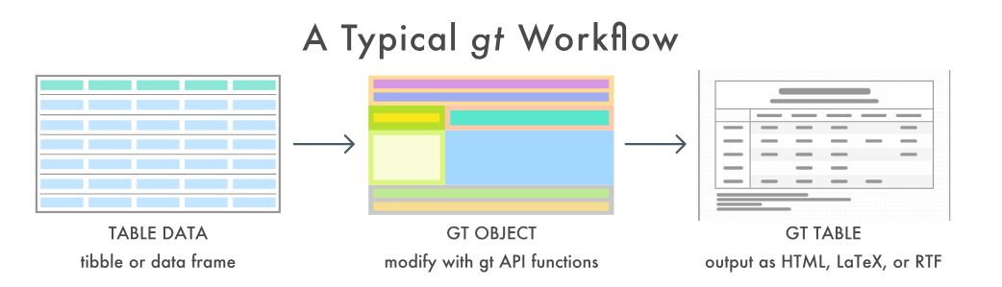

Slide 31
GT Package
With the gt package, anyone can make wonderful-looking tables using the R programming language. The gt philosophy: we can construct a wide variety of useful tables with a cohesive set of table parts. These include the table header, the stub, the stub head, the column labels, the table body, and the table footer.
Not yet on CRAN
Some limitations
Word, excel and PDF versions in progress

Slide 32
library(tidymodels)

Slide 33
Library(tidymodels)
tidymodels - meta-package (e.g., tidyverse), it’s a group of packages: https://github.com/tidymodels
recipes - data preprocessing
parsnip - unified interface to models
rsample - resampling data
dial - tune model parameters
yardstick - model performance

Slide 34
tag_attach()
Function to install need-specific packages e.g.
tag_attach("text analysis")
#> ── Attaching packages ───────────────────────────────── tidymodels 0.0.1 ── #> ✔ tidytext 0.1.9 ✔ keras 2.1.6
Bayesian
Deep learning
Feature engineering
Parallel processing
Resampling
Text analysis
Time series

Slide 35
How much tidyeval does one need to know/use?

Slide 36

From Jenny Bryan’s talk for rstudio::conf 2019, 2019 January 15018, Austin, TX: https://github.com/jennybc/tidy-eval-context

Slide 37
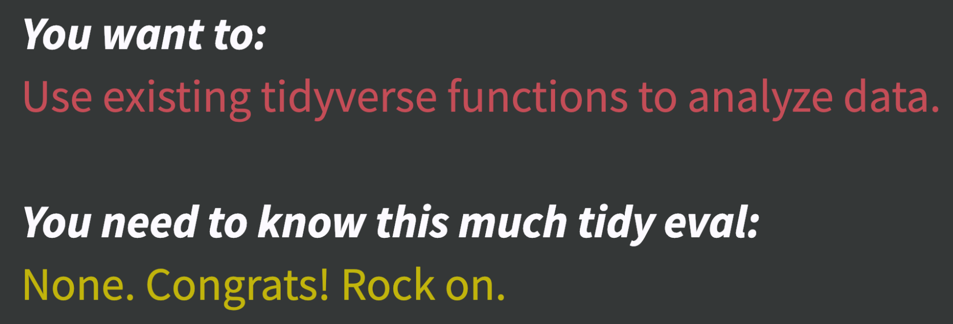
From Jenny Bryan’s talk for rstudio::conf 2019, 2019 January 15018, Austin, TX: https://github.com/jennybc/tidy-eval-context

Slide 38
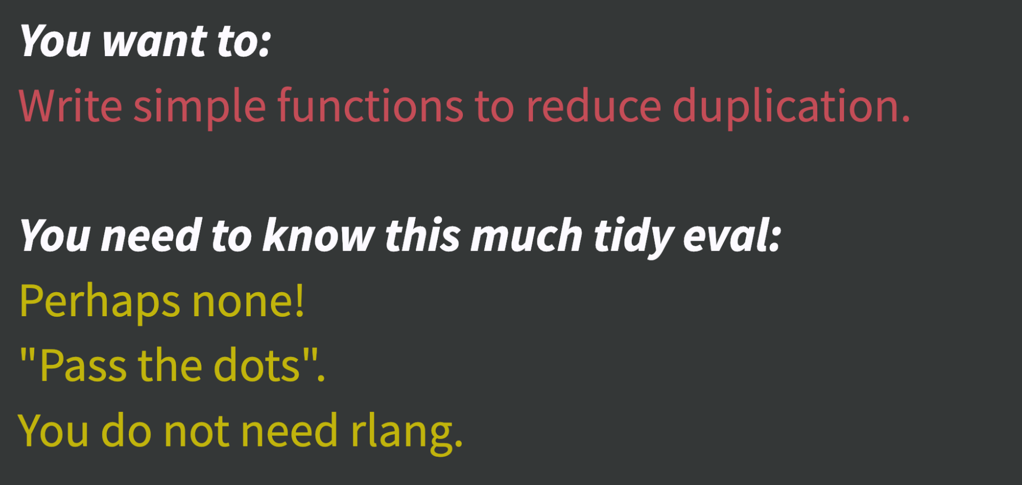
From Jenny Bryan’s talk for rstudio::conf 2019, 2019 January 15018, Austin, TX: https://github.com/jennybc/tidy-eval-context

Slide 39
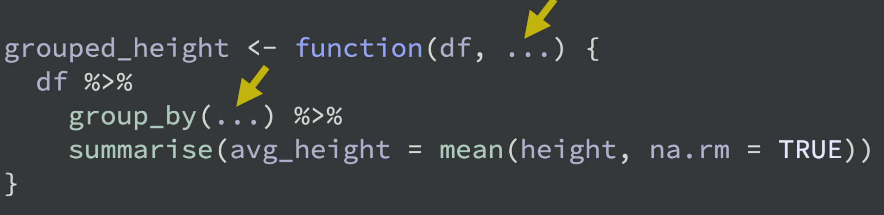
From Jenny Bryan’s talk for rstudio::conf 2019, 2019 January 15018, Austin, TX: https://github.com/jennybc/tidy-eval-context

Slide 40
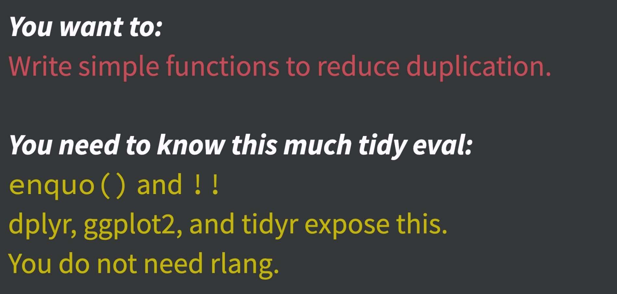
From Jenny Bryan’s talk for rstudio::conf 2019, 2019 January 15018, Austin, TX: https://github.com/jennybc/tidy-eval-context

Slide 41
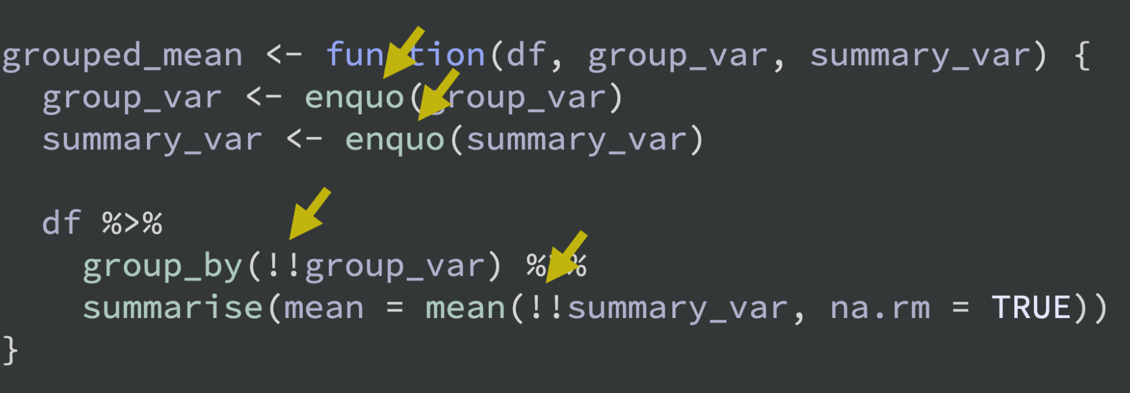
From Jenny Bryan’s talk for rstudio::conf 2019, 2019 January 15018, Austin, TX: https://github.com/jennybc/tidy-eval-context

Slide 42
Notable Mentions

Slide 43
Check out these talks
https://github.com/kbroman/RStudioConf2019Slides - workshop materials, slides, links to talks
https://resources.rstudio.com/keynotes-fireside-chats/opening-keynote-day2
Explicit Direct Instruction in Programming Education
https://resources.rstudio.com/rstudio-conf-2019/working-with-categorical-data-in-r-without-losing-your-mind
Working with Categorical Data in R without losing your mind

Slide 44
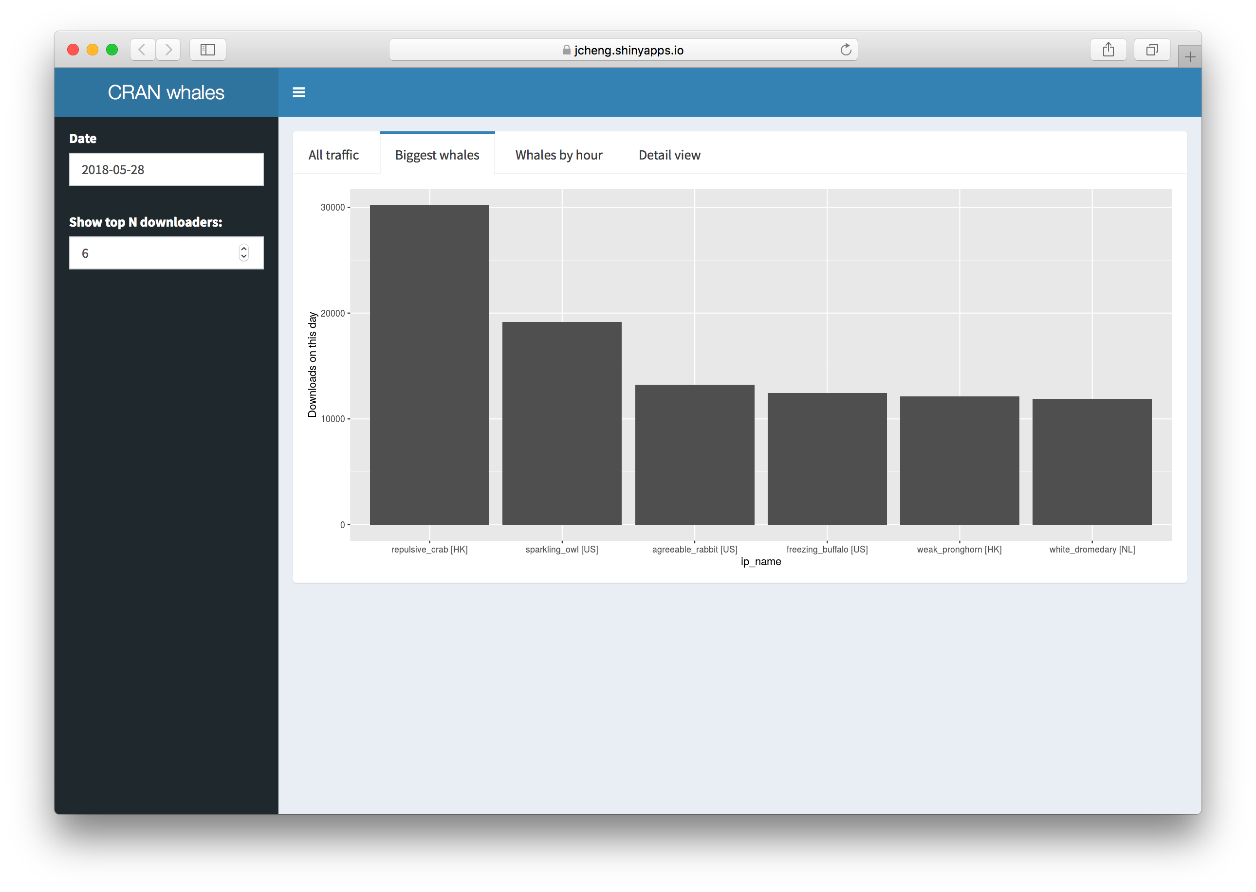
Cran Whales

Slide 45
Make the most of RStudio
RStudio Package Manager
Repository Management Server to organise and centralise packages
Share local packages
Restrict package access
Automate CRAN syncs
Offline access to CRAN
Control where and by whom packages are installed
RStudio Connect – publish from within RStudio IDE
Shiny applications
R Markdown
Plumber APIs
Dashboards
Schedule updates
Enterprise security

Slide 46
Make the most of RStudio
RStudio Server Pro
Access Rstudio from any web browser (available in opensource)
Run multiple analyses in parallel
Multiple versions of R (for those tricky packages)
Collaborative projects / follow cursor
Access user metrics in custom dashboard
All Pro features free if you teach R!

Slide 47
Summary
Friendly conference
Useful for new packages
Useful for collaboration
Useful for key skills

Slide 48

RStudio::conf 2020

Slide 49
Questions

